Slide 1
Module 1: Software Development Process
(Agile & Scrum)
Project Planning
and Management

Slide 2

Topics Covered
Software Lifecycle Models
SRS(Software Requirement Specification)
SPS(Software Project Scheduling)
GitHub
Frameworks like scrum,agile,etc.

Slide 3
Software Lifecycle Models
Software Development is the development of software for distinct purposes. For software development, there is a specific programming language like Java, Python, C/C++, etc. The entire process of software development isn’t as simple as its definition, it’s a complicated process. Accordingly, it requires an efficient approach from the developer in the form of the Software Development Life Cycle (SDLC).
Proper planning and execution are the key components of a successful software development process. The entire software development process includes 6 stages. Software Development Life Cycle (SDLC) is the common term to summarize these 6 stages.
SDLC specifies the task(s) to be performed at various stages by a software engineer/developer. It ensures that the end product is able to meet the customer’s expectations and fits in the overall budget. Hence, it’s vital for a software developer to have prior knowledge of this software development process.
These 6 stages are discussed below.

Slide 4
Stage-1: Planning And Requirement Analysis:
Stage-2: Defining Requirements:
Planning is the crucial step in everything and so as in software development. In this same stage, requirement analysis is also performed by the developers of the organization. This is attained from the inputs from the customers, sales department/market surveys.
The information from this analysis forms the building block of a basic project. The quality proof of the project is a result of planning. Thus, in this stage, the basic project is designed with all the available information.
In this stage, all the requirements for the target software are specified. These requirements get approval from the customers, market analysts, and stakeholders.
This is fulfilled by utilizing SRS (Software Requirement Specification). This is a sort of document that specifies all those things that need to be defined and created during the entire project cycle.

Slide 5
Stage-3: Designing Architecture:
Stage-4: Developing Product:
SRS is a reference for software designers to come out with the best architecture for the software. Hence, with the requirements defined in SRS, multiple designs for the product architecture are present in the Design Document Specification (DDS).
This DDS is assessed by market analysts and stakeholders. After evaluating all the possible factors, the most practical and logical design is chosen for the development.
At this stage, the fundamental development of the product starts. For this, developers use a specific programming code as per the design in the DDS. Hence, it is important for the coders to follow the protocols set by the association. Conventional programming tools like compilers, interpreters, debuggers, etc. are also put into use at this stage. Some popular languages like C/C++, Python, Java, etc. are put into use as per the software regulations.

Slide 6
Stage-5: Product Testing and Integration:
Stage 6: Deployment and Maintenance Of Product:
After the development of the product, testing of the software is necessary to ensure its smooth execution. Although, minimal testing is conducted at every stage of SDLC.
Therefore, at this stage, all the probable flaws are tracked, fixed, and retested. This ensures that the product confronts the quality requirements of SRS.
After detailed testing, the conclusive product is released in phases as per the organization’s strategy. Then it is tested in a real industrial environment. Because it is important to ensure its smooth performance. If it performs well, the organization sends out the product as a whole. After retrieving beneficial feedback, the company releases it as it is or with auxiliary improvements to make it further helpful for the customers. However, this alone is not enough. Therefore, along with the deployment, the product’s supervision.

Slide 7
Classic Waterfall Model
The classical waterfall model is the basic software development life cycle model. It is very simple but idealistic.
it is very important because all the other software development life cycle models are based on the classical waterfall model.
The classical waterfall model divides the life cycle into a set of phases. This model considers that one phase can be started after the completion of the previous phase. That is the output of one phase will be the input to the next phase. Thus the development process can be considered as a sequential flow in the waterfall. Here the phases do not overlap with each other. The different sequential phases of the classical waterfall model are shown in the below figure:

Slide 8
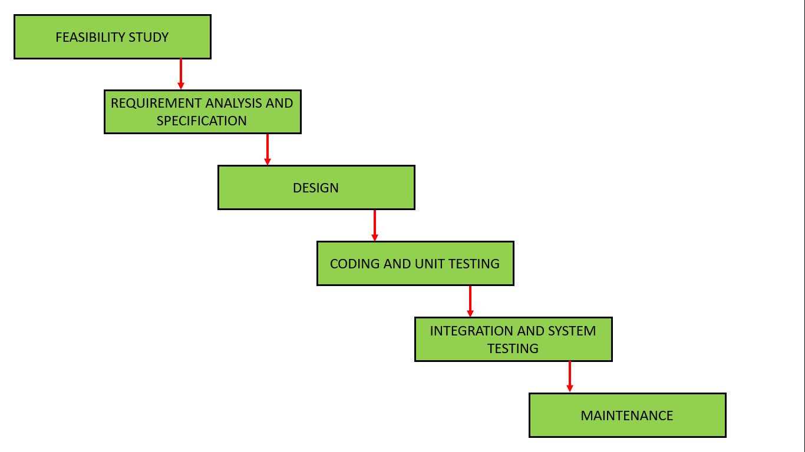

Slide 9
Feasibility Study:
The main goal of this phase is to determine whether it would be financially and technically feasible to develop the software.
The feasibility study involves understanding the problem and then determining the various possible strategies to solve the problem. These different identified solutions are analyzed based on their benefits and drawbacks, The best solution is chosen and all the other phases are carried out as per this solution strategy.

Slide 10
Requirements analysis and specification:
The aim of the requirement analysis and specification phase is to understand the exact requirements of the customer and document them properly. This phase consists of two different activities.
Requirement gathering and analysis: Firstly all the requirements regarding the software are gathered from the customer and then the gathered requirements are analyzed. The goal of the analysis part is to remove incompleteness (an incomplete requirement is one in which some parts of the actual requirements have been omitted) and inconsistencies (an inconsistent requirement is one in which some part of the requirement contradicts some other part).
Requirement specification: These analyzed requirements are documented in a software requirement specification (SRS) document. SRS document serves as a contract between the development team and customers. Any future dispute between the customers and the developers can be settled by examining the SRS document.

Slide 11
Design:
The goal of this phase is to convert the requirements acquired in the SRS into a format that can be coded in a programming language. It includes high-level and detailed design as well as the overall software architecture. A Software Design Document is used to document all of this effort (SDD)

Slide 12
Iterative Waterfall Model
So, the Iterative waterfall model can be thought of as incorporating the necessary changes to the classical waterfall model to make it usable in practical software development projects. It is almost the same as the classical waterfall model except some changes are made to increase the efficiency of the software development.
The iterative waterfall model provides feedback paths from every phase to its preceding phases, which is the main difference from the classical waterfall model.
Feedback paths introduced by the iterative waterfall model are shown in the figure below.

Slide 13
Coding and Unit testing :
In the coding phase software design is translated into source code using any suitable programming language. Thus each designed module is coded. The aim of the unit testing phase is to check whether each module is working properly or not.

Slide 14
Integration and System testing:
Integration of different modules are undertaken soon after they have been coded and unit tested. Integration of various modules is carried out incrementally over a number of steps. During each integration step, previously planned modules are added to the partially integrated system and the resultant system is tested. Finally, after all the modules have been successfully integrated and tested, the full working system is obtained and system testing is carried out on this.
System testing consists of three different kinds of testing activities as described below :
Alpha testing: Alpha testing is the system testing performed by the development team.
Beta testing: Beta testing is the system testing performed by a friendly set of customers.
Acceptance testing: After the software has been delivered, the customer performed acceptance testing to determine whether to accept the delivered software or reject it.

Slide 15
Maintenance:
Maintenance is the most important phase of a software life cycle. The effort spent on maintenance is 60% of the total effort spent to develop a full software. There are basically three types of maintenance :
Corrective Maintenance: This type of maintenance is carried out to correct errors that were not discovered during the product development phase.
Perfective Maintenance: This type of maintenance is carried out to enhance the functionalities of the system based on the customer’s request.
Adaptive Maintenance: Adaptive maintenance is usually required for porting the software to work in a new environment such as working on a new computer platform or with a new operating system.

Slide 16
Iterative Waterfall Model
When errors are detected at some later phase, these feedback paths allow correcting errors committed by programmers during some phase. The feedback paths allow the phase to be reworked in which errors are committed and these changes are reflected in the later phases. But, there is no feedback path to the stage – feasibility study, because once a project has been taken, does not give up the project easily.
It is good to detect errors in the same phase in which they are committed. It reduces the effort and time required to correct the errors.

Slide 17
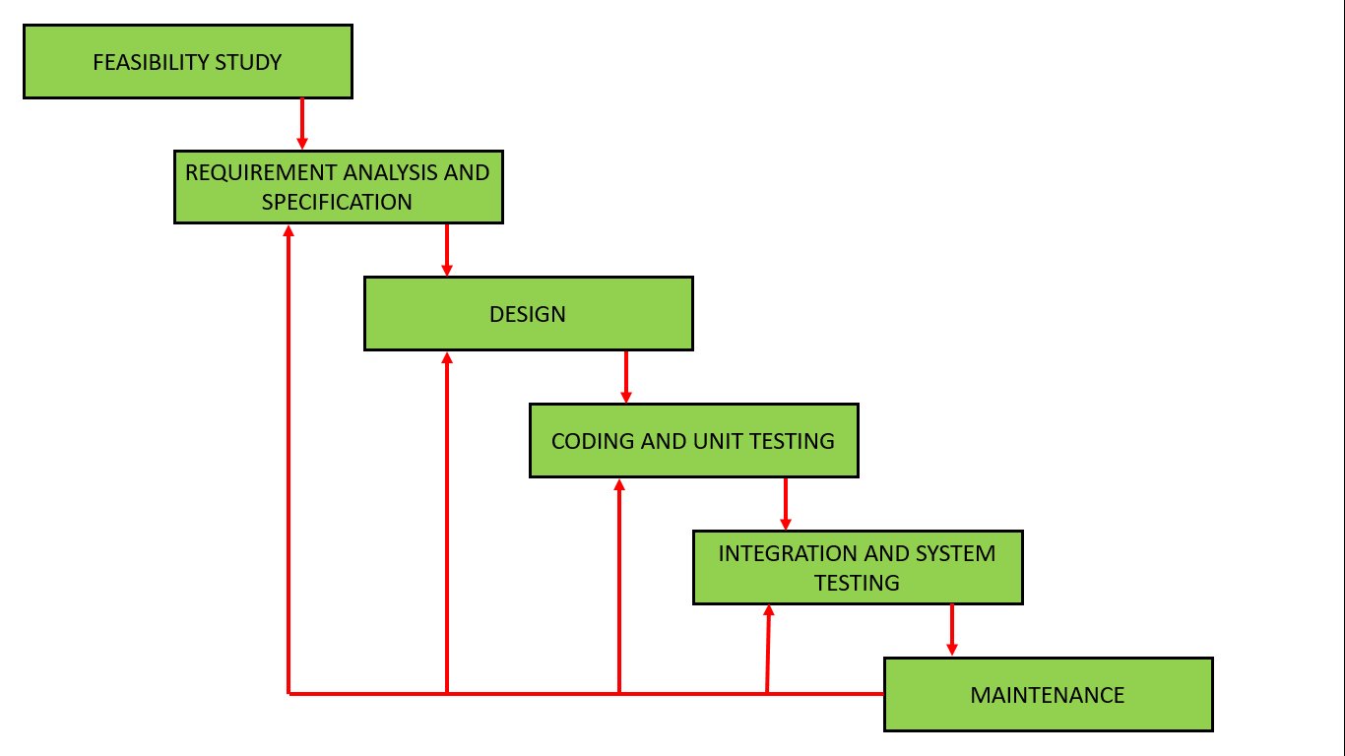

Slide 18
Advantages of Iterative Waterfall Model :
Feedback Path – In the classical waterfall model, there are no feedback paths, so there is no mechanism for error correction. But in the iterative waterfall model feedback path from one phase to its preceding phase allows correcting the errors that are committed and these changes are reflected in the later phases.
Simple – Iterative waterfall model is very simple to understand and use. That’s why it is one of the most widely used software development models.
Cost-Effective – It is highly cost-effective to change the plan or requirements in the model. Moreover, it is best suited for agile organizations.
Well-organized – In this model, less time is consumed on documenting and the team can spend more time on development and designing.

Slide 19
Spiral Model
Spiral model is one of the most important Software Development Life Cycle models, which provides support for Risk Handling. In its diagrammatic representation, it looks like a spiral with many loops. The exact number of loops of the spiral is unknown and can vary from project to project. Each loop of the spiral is called a Phase of the software development process. The exact number of phases needed to develop the product can be varied by the project manager depending upon the project risks. As the project manager dynamically determines the number of phases, so the project manager has an important role to develop a product using the spiral model.
The Radius of the spiral at any point represents the expenses(cost) of the project so far, and the angular dimension represents the progress made so far in the current phase.

Slide 20
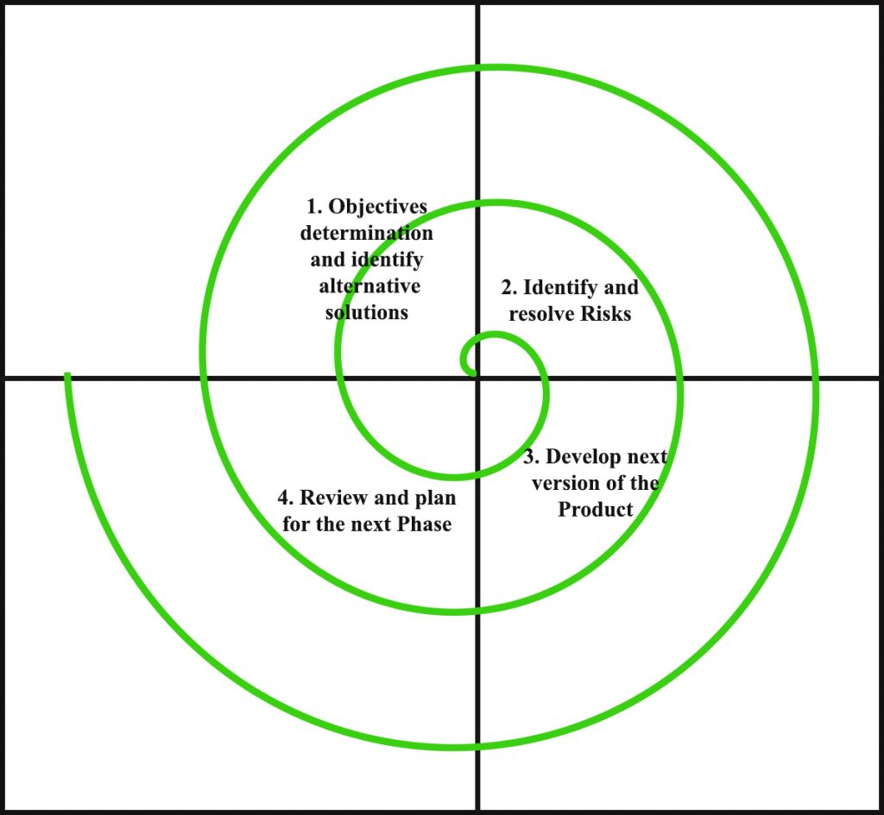

Slide 21
Each phase of the Spiral Model is divided into four quadrants as shown in the above figure. The functions of these four quadrants are discussed below-
Objectives determination and identify alternative solutions:
Identify and resolve Risks:
Requirements are gathered from the customers and the objectives are identified, elaborated, and analyzed at the start of every phase. Then alternative solutions possible for the phase are proposed in this quadrant.
During the second quadrant, all the possible solutions are evaluated to select the best possible solution. Then the risks associated with that solution are identified and the risks are resolved using the best possible strategy. At the end of this quadrant, the Prototype is built for the best possible solution.
Develop next version of the Product:
Review and plan for the next Phase:
During the third quadrant, the identified features are developed and verified through testing. At the end of the third quadrant, the next version of the software is available.
̌In the fourth quadrant, the Customers evaluate the so far developed version of the software. In the end, planning for the next phase is started.

Slide 22
Risk Handling in Spiral Model
A risk is any adverse situation that might affect the successful completion of a software project. The most important feature of the spiral model is handling these unknown risks after the project has started. Such risk resolutions are easier done by developing a prototype. The spiral model supports coping up with risks by providing the scope to build a prototype at every phase of the software development.
The Prototyping Model also supports risk handling, but the risks must be identified completely before the start of the development work of the project. But in real life project risk may occur after the development work starts, in that case, we cannot use the Prototyping Model. In each phase of the Spiral Model, the features of the product dated and analyzed, and the risks at that point in time are identified and are resolved through prototyping. Thus, this model is much more flexible compared to other SDLC models.

Slide 23
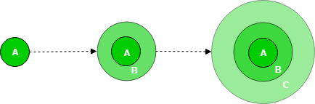
Incremental Process Model
The incremental process model is also known as the Successive version model.
First, a simple working system implementing only a few basic features is built and then that is delivered to the customer. Then thereafter many successive iterations/ versions are implemented and delivered to the customer until the desired system is released.
A, B, and C are modules of Software Products that are incrementally developed and delivered.

Slide 24
Life cycle activities:
`--------------------------------------------------------------------------------------------------------------------------------------------------------------------------------------------------------------------------------------------------------------------------------------------------------------------------------------------------------------------------------------------------------------------------------------------------------------------------------------------------------------------------------------------------------------------------------------------------------------------------------------------------------------------------------------------------------------------------------------------------------------------------------------------------------------------------------------
Requirements of Software are first broken down into several modules that can be incrementally constructed and delivered. At any time, the plan is made just for the next increment and not for any kind of long-term plan. Therefore, it is easier to modify the version as per the need of the customer. The Development Team first undertakes to develop core features (these do not need services from other features) of the system.
Once the core features are fully developed, then these are refined to increase levels of capabilities by adding new functions in Successive versions. Each incremental version is usually developed using an iterative waterfall model of development.
As each successive version of the software is constructed and delivered, now the feedback of the Customer is to be taken and these were then incorporated into the next version. Each version of the software has more additional features than the previous ones.
After Requirements gathering and specification, requirements are then split into several different versions starting with version 1, in each successive increment, the next version is constructed and then deployed at the customer site. After the last version (version n), it is now deployed at the client site.

Slide 25
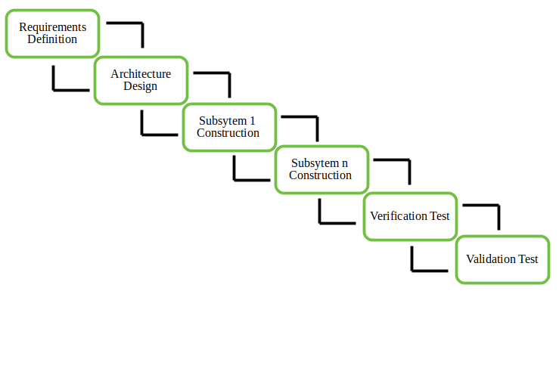
Types of Incremental model:
1.
Staged Delivery Model:
Construction of only one part of the project at a time.

Slide 26
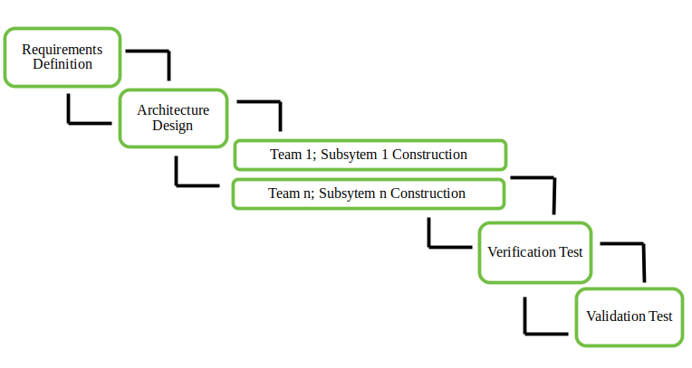
Types of Incremental model:
2.
Parallel Development Model – Different subsystems are developed at the same time. It can decrease the calendar time needed for the development, i.e. TTM (Time to Market) if enough resources are available.

Slide 27
Rapid Application Development Model
The Rapid Application Development Model was first proposed by IBM in the 1980s. The critical feature of this model is the use of powerful development tools and techniques. A software project can be implemented using this model if the project can be broken down into small modules wherein each module can be assigned independently to separate teams. These modules can finally be combined to form the final product. Development of each module involves the various basic steps as in the waterfall model i.e analyzing, designing, coding, and then testing, etc. as shown in the figure. Another striking feature of this model is a short time span i.e the time frame for delivery(time-box) is generally 60-90 days.

Slide 28
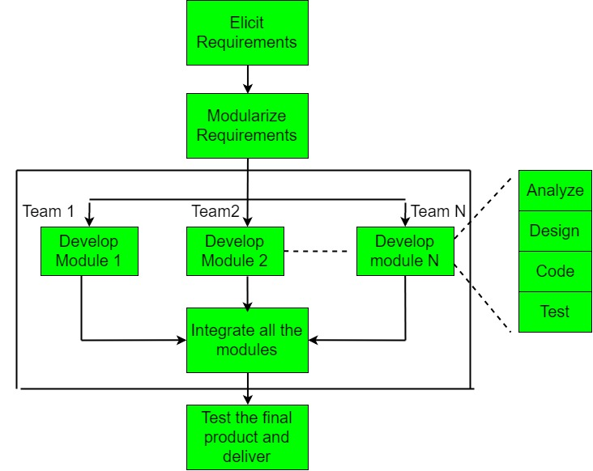

Slide 29
The use of powerful developer tools such as JAVA, C++, Visual BASIC, XML, etc. is also an integral part of the projects. This model consists of 4 basic phases:
Requirements Planning – It involves the use of various techniques used in requirements elicitation like brainstorming, task analysis, form analysis, user scenarios, FAST (Facilitated Application Development Technique), etc. It also consists of the entire structured plan describing the critical data, methods to obtain it, and then processing it to form a final refined model.
User Description – This phase consists of taking user feedback and building the prototype using developer tools. In other words, it includes re-examination and validation of the data collected in the first phase. The dataset attributes are also identified and elucidated in this phase.
Construction – In this phase, refinement of the prototype and delivery takes place. It includes the actual use of powerful automated tools to transform process and data models into the final working product. All the required modifications and enhancements are too done in this phase.
Cutover – All the interfaces between the independent modules developed by separate teams have to be tested properly. The use of powerfully automated tools and subparts makes testing easier. This is followed by acceptance testing by the user.
The process involves building a rapid prototype, delivering it to the customer, and taking feedback. After validation by the customer, the SRS document is developed and the design is finalized.

Slide 30
Software Requirement Specification
Requirements engineering is the process of identifying, eliciting, analyzing, specifying, validating, and managing the needs and expectations of stakeholders for a software system. The requirements engineering process is an iterative process that involves several steps, including:
Requirements Elicitation: This is the process of gathering information about the needs and expectations of stakeholders for the software system. This step involves interviews, surveys, focus groups, and other techniques to gather information from stakeholders.
Requirements Analysis: This step involves analyzing the information gathered in the requirements elicitation step to identify the high-level goals and objectives of the software system. It also involves identifying any constraints or limitations that may affect the development of the software system.
Requirements Specification: This step involves documenting the requirements identified in the analysis step in a clear, consistent, and unambiguous manner. This step also involves prioritizing and grouping the requirements into manageable chunks.

Slide 31
Software Requirement Specification
Requirements Validation: This step involves checking that the requirements are complete, consistent, and accurate. It also involves checking that the requirements are testable and that they meet the needs and expectations of stakeholders.
Requirements Management: This step involves managing the requirements throughout the software development life cycle, including tracking and controlling changes, and ensuring that the requirements are still valid and relevant. The Requirements Engineering process is a critical step in the software development life cycle as it helps to ensure that the software system being developed meets the needs and expectations of stakeholders, and that it is developed on time, within budget, and to the required quality.
Requirement Engineering is the process of defining, documenting and maintaining the requirements. It is a process of gathering and defining service provided by the system. it is the disciplined application of proven principle , methods ,tools and notations to describe a proposed system’s intended behavior and its associated constraints.

Slide 32
Tools involved in requirement engineering:
Requirements Engineering Process consists of the following main activities:
observation report
Questionnaire ( survey , poll )
Use cases
User stories
Requirement workshop
Mind mapping
Role playing
Prototyping
Requirements elicitation
Requirements specification
Requirements verification and validation
Requirements management

Slide 33
Requirements Elicitation:
It is related to the various ways used to gain knowledge about the project domain and requirements. The various sources of domain knowledge include customers, business manuals, the existing software of same type, standards and other stakeholders of the project. The techniques used for requirements elicitation include interviews, brainstorming, task analysis, Delphi technique, prototyping, etc. Some of these are discussed here. Elicitation does not produce formal models of the requirements understood. Instead, it widens the domain knowledge of the analyst and thus helps in providing input to the next stage.
Requirements elicitation is the process of gathering information about the needs and expectations of stakeholders for a software system. This is the first step in the requirements engineering process and it is critical to the success of the software development project. The goal of this step is to understand the problem that the software system is intended to solve, and the needs and expectations of the stakeholders who will use the system.

Slide 34
Requirements Elicitation:
There are several techniques that can be used to elicit requirements, including:
Interviews: These are one-on-one conversations with stakeholders to gather information about their needs and expectations.
Surveys: These are questionnaires that are distributed to stakeholders to gather information about their needs and expectations.
Focus Groups: These are small groups of stakeholders who are brought together to discuss their needs and expectations for the software system.
Observation: This technique involves observing the stakeholders in their work environment to gather information about their needs and expectations.
Prototyping: This technique involves creating a working model of the software system, which can be used to gather feedback from stakeholders and to validate requirements.
It’s important to document, organize and prioritize the requirements obtained from all these techniques to ensure that they are complete, consistent and accurate.

Slide 35
Requirements specification:
This activity is used to produce formal software requirement models. All the requirements including the functional as well as the non-functional requirements and the constraints are specified by these models in totality. During specification, more knowledge about the problem may be required which can again trigger the elicitation process. The models used at this stage include ER diagrams, data flow diagrams(DFDs), function decomposition diagrams(FDDs), data dictionaries, etc.
Requirements specification is the process of documenting the requirements identified in the analysis step in a clear, consistent, and unambiguous manner. This step also involves prioritizing and grouping the requirements into manageable chunks.
The goal of this step is to create a clear and comprehensive document that describes the requirements for the software system. This document should be understandable by both the development team and the stakeholders.

Slide 36
Requirements specification:
There are several types of requirements that are commonly specified in this step, including:
Functional Requirements: These describe what the software system should do. They specify the functionality that the system must provide, such as input validation, data storage, and user interface.
Non-Functional Requirements: These describe how well the software system should do it. They specify the quality attributes of the system, such as performance, reliability, usability, and security.
Constraints: These describe any limitations or restrictions that must be considered when developing the software system.
Acceptance Criteria: These describe the conditions that must be met for the software system to be considered complete and ready for release.
In order to make the requirements specification clear, the requirements should be written in a natural language and use simple terms, avoiding technical jargon, and using a consistent format throughout the document. It is also important to use diagrams, models, and other visual aids to help communicate the requirements effectively.
Once the requirements are specified, they must be reviewed and validated by the stakeholders and development team to ensure that they are complete, consistent, and accurate.

Slide 37
Requirements verification and validation:
Verification: It refers to the set of tasks that ensures that the software correctly implements a specific function.
Validation: It refers to a different set of tasks that ensures that the software that has been built is traceable to customer requirements. If requirements are not validated, errors in the requirement definitions would propagate to the successive stages resulting in a lot of modification and rework. The main steps for this process include:
The requirements should be consistent with all the other requirements i.e no two requirements should conflict with each other.
The requirements should be complete in every sense.
The requirements should be practically achievable.
Reviews, buddy checks, making test cases, etc. are some of the methods used for this.
Requirements verification and validation (V&V) is the process of checking that the requirements for a software system are complete, consistent, and accurate, and that they meet the needs and expectations of the stakeholders. The goal of V&V is to ensure that the software system being developed meets the requirements and that it is developed on time, within budget, and to the required quality.

Slide 38
Requirements verification and validation:
Verification is the process of checking that the requirements are complete, consistent, and accurate. It involves reviewing the requirements to ensure that they are clear, testable, and free of errors and inconsistencies. This can include reviewing the requirements document, models, and diagrams, and holding meetings and walkthroughs with stakeholders.
Validation is the process of checking that the requirements meet the needs and expectations of the stakeholders. It involves testing the requirements to ensure that they are valid and that the software system being developed will meet the needs of the stakeholders. This can include testing the software system through simulation, testing with prototypes, and testing with the final version of the software.
V&V is an iterative process that occurs throughout the software development life cycle. It is important to involve stakeholders and the development team in the V&V process to ensure that the requirements are thoroughly reviewed and tested.
It’s important to note that V&V is not a one-time process, but it should be integrated and continue throughout the software development process and even in the maintenance stage.

Slide 39
Requirements management:
Requirement management is the process of analyzing, documenting, tracking, prioritizing and agreeing on the requirement and controlling the communication to relevant stakeholders. This stage takes care of the changing nature of requirements. It should be ensured that the SRS is as modifiable as possible so as to incorporate changes in requirements specified by the end users at later stages too. Being able to modify the software as per requirements in a systematic and controlled manner is an extremely important part of the requirements engineering process.
Requirements management is the process of managing the requirements throughout the software development life cycle, including tracking and controlling changes, and ensuring that the requirements are still valid and relevant. The goal of requirements management is to ensure that the software system being developed meets the needs and expectations of the stakeholders and that it is developed on time, within budget, and to the required quality.

Slide 40
Requirements management:
There are several key activities that are involved in requirements management, including:
Tracking and controlling changes: This involves monitoring and controlling changes to the requirements throughout the development process, including identifying the source of the change, assessing the impact of the change, and approving or rejecting the change.
Version control: This involves keeping track of different versions of the requirements document and other related artifacts.
Traceability: This involves linking the requirements to other elements of the development process, such as design, testing, and validation.
Communication: This involves ensuring that the requirements are communicated effectively to all stakeholders and that any changes or issues are addressed in a timely manner.
Monitoring and reporting: This involves monitoring the progress of the development process and reporting on the status of the requirements.

Slide 41
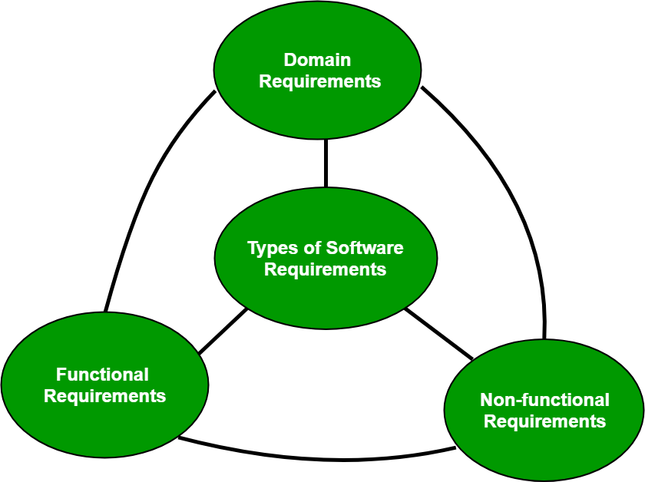
Classification of Software Requirements
A software requirement can be of 3 types:
Functional requirements
Non-functional requirements
Domain requirements

Slide 42
Functional Requirements:
These are the requirements that the end user specifically demands as basic facilities that the system should offer. It can be a calculation, data manipulation, business process, user interaction, or any other specific functionality which defines what function a system is likely to perform. All these functionalities need to be necessarily incorporated into the system as a part of the contract. These are represented or stated in the form of input to be given to the system, the operation performed and the output expected. They are basically the requirements stated by the user which one can see directly in the final product, unlike the non-functional requirements.
For example, in a hospital management system, a doctor should be able to retrieve the information of his patients. Each high-level functional requirement may involve several interactions or dialogues between the system and the outside world. In order to accurately describe the functional requirements, all scenarios must be enumerated. There are many ways of expressing functional requirements e.g., natural language, a structured or formatted language with no rigorous syntax and formal specification language with proper syntax. Functional Requirements in Software Engineering are also called Functional Specification.

Slide 43
Non-functional requirements:
These are basically the quality constraints that the system must satisfy according to the project contract.Nonfunctional requirements, not related to the system functionality, rather define how the system should perform The priority or extent to which these factors are implemented varies from one project to other. They are also called non-behavioral requirements. They basically deal with issues like:
Portability
Security
Maintainability
Reliability
Scalability
Performance
Reusability
Flexibility

Slide 44
Non-functional requirements:
NFR’s are classified into following types:
Interface constraints
Performance constraints: response time, security, storage space, etc.
Operating constraints
Life cycle constraints: maintainability, portability, etc.
Economic constraints
The process of specifying non-functional requirements requires the knowledge of the functionality of the system, as well as the knowledge of the context within which the system will operate.

Slide 45
Domain requirements:
Domain requirements are the requirements which are characteristic of a particular category or domain of projects. Domain requirements can be functional or nonfunctional. Domain requirements engineering is a continuous process of proactively defining the requirements for all foreseeable applications to be developed in the software product line. The basic functions that a system of a specific domain must necessarily exhibit come under this category. For instance, in an academic software that maintains records of a school or college, the functionality of being able to access the list of faculty and list of students of each grade is a domain requirement. These requirements are therefore identified from that domain model and are not user specific.

Slide 46
SRS
A software requirements specification (SRS) is a description of a software system to be developed. It lays out functional and non-functional requirements and may include a set of use cases that describe user interactions that the software must provide.
The output of requirement engineering is the requirement specification document (SRD). it can be considered as a contract between the development team and the customer which can be also used to resolve any disagreement that may arise in future.
it is the specification for the particular software product , program or set of programs that perform certain function. it serves a number of purposes depending upon who is writing it. the srs document must be written in two phase:
First SRS should be written by the customer and second SRS should be written by the developer. first srs is used to define an expectations of the user and second srs is written for different purpose and serves as a contract document between customer and developer.

Slide 47
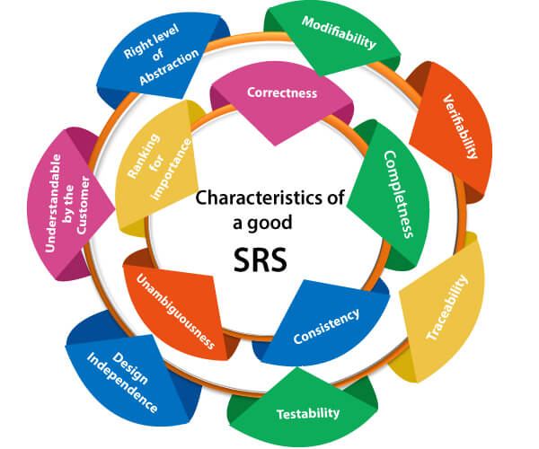
In order to fully understand one’s project, it is very important that they come up with an SRS listing out their requirements, how are they going to meet them and how will they complete the project. It helps the team to save upon their time as they are able to comprehend how are going to go about the project. Doing this also enables the team to find out about the limitations and risks early on.

Slide 48
Correctness:
User review is used to ensure the correctness of requirements stated in the SRS. SRS is said to be correct if it covers all the requirements that are actually expected from the system.
Completeness:
Completeness of SRS indicates every sense of completion including the numbering of all the pages, resolving the to be determined parts to as much extent as possible as well as covering all the functional and non-functional requirements properly.
Consistency:
Requirements in SRS are said to be consistent if there are no conflicts between any set of requirements. Examples of conflict include differences in terminologies used at separate places, logical conflicts like time period of report generation, etc.

Slide 49
Unambiguousness:
A SRS is said to be unambiguous if all the requirements stated have only 1 interpretation. Some of the ways to prevent unambiguousness include the use of modelling techniques like ER diagrams, proper reviews and buddy checks, etc.
Ranking for importance and stability:
There should a criterion to classify the requirements as less or more important or more specifically as desirable or essential. An identifier mark can be used with every requirement to indicate its rank or stability.
Modifiability:
SRS should be made as modifiable as possible and should be capable of easily accepting changes to the system to some extent. Modifications should be properly indexed and cross-referenced.

Slide 50
Verifiability:
A SRS is verifiable if there exists a specific technique to quantifiably measure the extent to which every requirement is met by the system. For example, a requirement starting that the system must be user-friendly is not verifiable and listing such requirements should be avoided.
Traceability:
One should be able to trace a requirement to design component and then to code segment in the program. Similarly, one should be able to trace a requirement to the corresponding test cases.
Design Independence:
There should be an option to choose from multiple design alternatives for the final system. More specifically, the SRS should not include any implementation details.

Slide 51
Testability:
A SRS should be written in such a way that it is easy to generate test cases and test plans from the document.
Understandable by the customer:
An end user maybe an expert in his/her specific domain but might not be an expert in computer science. Hence, the use of formal notations and symbols should be avoided to as much extent as possible. The language should be kept easy and clear.
Right level of abstraction:
If the SRS is written for the requirements phase, the details should be explained explicitly. Whereas, for a feasibility study, fewer details can be used. Hence, the level of abstraction varies according to the purpose of the SRS.

Slide 52
Project Plan: MeetUrMate
1.
Introduction
This document lays out a project plan for the development of the “MeetUrMate” open source repository system by Anurag Mishra.
The intended readers of this document are current and future developers working on “MeetUrMate” and the sponsors of the project. The plan will include, but is not restricted to, a summary of the system functionality, the scope of the project from the perspective of the “MeetUrMate” team (me and my mentors), scheduling and delivery estimates, project risks, and how those risks will be mitigated, the process by which I will develop the project, and metrics and measurements that will be recorded throughout the project.
2.
Overview
In today’s world, owning to the heavy workload on the employees, they are having a huge amount of stress in their lives. Even with the presence of so many gadgets in and around them, they are not able to relieve their stress. I aim to develop an application that would enable them to share the thing of their liking and meet the person who has the same passion as theirs. For eg. If someone wants to share their art, they can share it through the platform, if someone wants to sing any song, they can record it and share the same. They can also share videos (with some funny commentary in the background), share mysteries that other people can solve, post any question. Through my platform, I’ll enable them to meet people who share common interests and passions, chat with them, and have some fun.

Slide 53
Project Plan: MeetUrMate
2.1
Customers
Everyone. Anyone can use this application ranging from a child to an old-age person.
2.2
Functionality
Users should be able to register through their already existing accounts.
They should be able to share snaps/videos/snaps.
People should be able to like and comment on any post. One person can follow another person who shares common interests and likings which would enable them to find mates apart from their usual friend circle.
Each user can have his/her profile picture, status
People can post mysteries and other people can solve the mysteries.
Users will get points for the popularity of their posts/the number of mysteries they solve.
Add own funny commentary on any video
Post any questions regarding their interests and people can answer.

Slide 54
Project Plan: MeetUrMate
2.3
Platform
It will be launched both as a Web-based application and a Mobile app for Android.
2.4
Development Responsibility
I would be developing the software and I am responsible for the creation of the Database and all the other related kinds of stuff.

Slide 55
Project Plan: MeetUrMate
3.
Goals and Scopes
Users should be able to register through their already existing accounts.
They should be able to share snaps/videos/snaps.
People should be able to like and comment on any post.
One person can follow another person who shares common interests and likings which would enable them to find mates apart from their usual friend circle.
Each user can have his/her profile picture, status.
People can post mysteries and other people can solve the mysteries.
Users will get points for the popularity of their posts/the number of mysteries they solve.

Slide 56
Project Plan: MeetUrMate
4.
Deliverables
I’ll deliver the following during the course of development:
Feature specification
Product design
Test plan
Development document
Source code
5.
Risk Management
5.1
Risk Identification
Following will be the risk involved in my project:
1) People are already using Facebook to find friends. So, what would be the real cause that would motivate them to join my application?

Slide 57
Project Plan: MeetUrMate
5.2
Risk Mitigation
Even though most of the users would already be using Facebook, our platform would still offer them many things that are not there on Facebook. For eg.
They don’t meet people who share common interests and passions as much. Our application would enable them to meet people (apart from usual friends) who share common interests and passions on a more frequent basis.
Users of FB cannot share songs on the go that they have sung whereas on our app they can do that on the go.
People can post mysteries/cases and other people can solve them. Moreover, people will get points in case they solve the mysteries or on the basis of the popularity of their posts.
More importantly, people need not register for my application, instead, they can log in using their already existing accounts of Google/Facebook.
Thus, I think that there is a considerable amount of difference between Facebook/Instagram/Twitter and my application and it would attract many people.

Slide 58
Scheduling and Estimates
Milestone | Description | Release Date | Release
 |  |  | Iteration
M1 | Application view and Design | October 5, 2015 | R1
 | (Front-end development)
M2 | Database for my application | October 17, 2015 | R1
 | (Back-end)
M3 | Integrating views and designs | November 12, 2015 | R1
 | (Integrating front-end and
 | back-end)
M4 | Testing for initial release | November 20, 20015 | R2
M5 | Issue tracker, user reviews, | December 1, 2015 | R2
 | web design integration
M6 | Final release | December 23, 2015 | R2

Slide 59
Project Plan: MeetUrMate
7.
Technical Process
Following would be the languages I would use to develop my application within the stipulated time period:
Front-end development: Jquery, HTML, CSS, PHP.
Back-end development: PHP, MySQL.
For Android app: Java on Android SDK.

Slide 60
Software Project Scheduling
A schedule in your project’s time table actually consists of sequenced activities and milestones that are needed to be delivered under a given period of time.
Project schedule simply means a mechanism that is used to communicate and know about that tasks are needed and has to be done or performed and which organizational resources will be given or allocated to these tasks and in what time duration or time frame work is needed to be performed. Effective project scheduling leads to success of project, reduced cost, and increased customer satisfaction. Scheduling in project management means to list out activities, deliverables, and milestones within a project that are delivered. It contains more notes than your average weekly planner notes. The most common and important form of project schedule is Gantt chart.

Slide 61
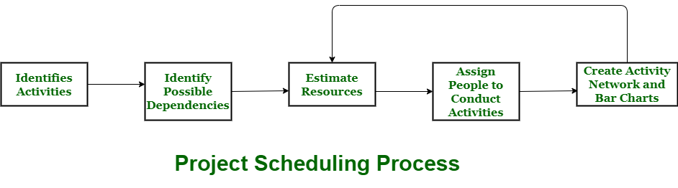

Slide 62

Process :
The manager needs to estimate time and resources of project while scheduling project. All activities in project must be arranged in a coherent sequence that means activities should be arranged in a logical and well-organized manner for easy to understand. Initial estimates of project can be made optimistically which means estimates can be made when all favorable things will happen and no threats or problems take place.
The total work is separated or divided into various small activities or tasks during project schedule. Then, Project manager will decide time required for each activity or task to get completed. Even some activities are conducted and performed in parallel for efficient performance. The project manager should be aware of fact that each stage of project is not problem-free.

Slide 63
Problems arise during Project Development Stage :
People may leave or remain absent during particular stage of development.
Hardware may get failed while performing.
Software resource that is required may not be available at present, etc.
The project schedule is represented as set of chart in which work-breakdown structure and dependencies within various activities are represented. To accomplish and complete project within a given schedule, required resources must be available when they are needed. Therefore, resource estimation should be done before starting development.

Slide 64
Resources required for Development of Project :
1
2
3
Human effort
Sufficient disk space on server
Specialized hardware
4
5
Software technology
Travel allowance required by project staff, etc.

Slide 65
Advantages of Project Scheduling :
There are several advantages provided by project schedule in our project management:
It simply ensures that everyone remains on same page as far as tasks get completed, dependencies, and deadlines.
It helps in identifying issues early and concerns such as lack or unavailability of resources.
It also helps to identify relationships and to monitor process.
It provides effective budget management and risk mitigation.

Slide 66
GitHub
Git is a free and open-source distributed version control system designed to handle everything from small to very large projects with speed and efficiency.
Git relies on the basis of distributed development of software where more than one developer may have access to the source code of a specific application and can modify changes to it that may be seen by other developers..
Initially designed and developed by Linus Torvalds for Linux kernel development in 2005.
Every git working directory is a full-fledged repository with complete history and full version tracking capabilities, independent of network access or a central server.
Git allows a team of people to work together, all using the same files. And it helps the team cope with the confusion that tends to happen when multiple people are editing the same files.

Slide 67
Version control systems are a category of software tools that helps in recording changes made to files by keeping a track of modifications done in the code.
Why Version Control system is so Important?
As we know that a software product is developed in collaboration by a group of developers they might be located at different locations and each one of them contributes to some specific kind of functionality/features. So in order to contribute to the product, they made modifications to the source code(either by adding or removing). A version control system is a kind of software that helps the developer team to efficiently communicate and manage(track) all the changes that have been made
to the source code along with the information like who made and what changes have been made. A separate branch is created for every contributor who made the changes and the changes aren’t merged into the original source code unless all are analyzed as soon as the changes are green signaled they merged to the main source code. It not only keeps source code organized but also improves productivity by making the development process smooth.
Basically Version control system keeps track on changes made on a particular software and take a snapshot of every modification. Let’s suppose if a team of developer add some new functionalities in an application and the updated version is not working properly so as the version control system keeps track of our work so with the help of version control system we can omit the new changes and continue with the previous version.

Slide 68
Benefits of the version control system:
Enhances the project development speed by providing efficient collaboration,
Leverages the productivity, expedites product delivery, and skills of the employees through better communication and assistance,
Reduce possibilities of errors and conflicts meanwhile project development through traceability to every small change,
Employees or contributors of the project can contribute from anywhere irrespective of the different geographical locations through this VCS,
For each different contributor to the project, a different working copy is maintained and not merged to the main file unless the working copy is validated. The most popular example is Git, Helix core, Microsoft TFS,
Helps in recovery in case of any disaster or contingent situation,
Informs us about Who, What, When, Why changes have been made.

Slide 69
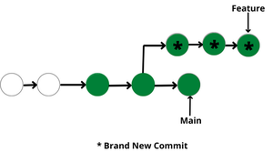
Use of Version Control System:
A repository: It can be thought of as a database of changes. It contains all the edits and historical versions (snapshots) of the project.
Copy of Work (sometimes called as checkout): It is the personal copy of all the files in a project. You can edit to this copy, without affecting the work of others and you can finally commit your changes to a repository when you are done making your changes.
Working in a group: Consider yourself working in a company where you are asked to work on some live project. You can’t change the main code as it is in production, and any change may cause inconvenience to the user, also you are working in a team so you need to collaborate with your team to and adapt their changes. Version control helps you with the, merging different requests to main repository without making any undesirable changes. You may test the functionalities without putting it live, and you don’t need to download and set up each time, just pull the changes and do the changes, test it and merge it back. It may be visualized as.

Slide 70
Purpose of Version Control:
Multiple people can work simultaneously on a single project. Everyone works on and edits their own copy of the files and it is up to them when they wish to share the changes made by them with the rest of the team.
It also enables one person to use multiple computers to work on a project, so it is valuable even if you are working by yourself.
It integrates the work that is done simultaneously by different members of the team. In some rare cases, when conflicting edits are made by two people to the same line of a file, then human assistance is requested by the version control system in deciding what should be done.
Version control provides access to the historical versions of a project. This is insurance against computer crashes or data loss. If any mistake is made, you can easily roll back to a previous version. It is also possible to undo specific edits that too without losing the work done in the meanwhile. It can be easily known when, why, and by whom any part of a file was edited.

Slide 71
Types of Version Control Systems:
Local Version Control Systems
Centralized Version Control Systems
Distributed Version Control Systems
Local Version Control Systems: It is one of the simplest forms and has a database that kept all the changes to files under revision control. RCS is one of the most common VCS tools. It keeps patch sets (differences between files) in a special format on disk. By adding up all the patches it can then re-create what any file looked like at any point in time.

Slide 72
Types of Version Control Systems:
Centralized Version Control Systems: Centralized version control systems contain just one repository globally and every user need to commit for reflecting one’s changes in the repository. It is possible for others to see your changes by updating.
Two things are required to make your changes visible to others which are:
The benefit of CVCS (Centralized Version Control Systems) makes collaboration amongst developers along with providing an insight to a certain extent on what everyone else is doing on the project. It allows administrators to fine-grained control over who can do what.
It has some downsides as well which led to the development of DVS. The most obvious is the single point of failure that the centralized repository represents if it goes down during that period collaboration and saving versioned changes is not possible. What if the hard disk of the central database becomes corrupted, and proper backups haven’t been kept? You lose absolutely everything.
They update
You commit

Slide 73
Types of Version Control Systems:
Distributed Version Control Systems: Distributed version control systems contain multiple repositories. Each user has their own repository and working copy. Just committing your changes will not give others access to your changes. This is because commit will reflect those changes in your local repository and you need to push them in order to make them visible on the central repository. Similarly, When you update, you do not get others’ changes unless you have first pulled those changes into your repository.
To make your changes visible to others, 4 things are required:
The most popular distributed version control systems are Git, and Mercurial. They help us overcome the problem of single point of failure.
You commit
You push
They pull
They update

Slide 74
Characteristics of Git
A. Strong support for non-linear development
Git supports rapid branching and merging and includes specific tools for visualizing and navigating a non-linear development history.
A major assumption in Git is that a change will be merged more often than it is written.
Branches in Git are very lightweight.
B. Distributed development
Git provides each developer a local copy of the entire development history, and changes are copied from one such repository to another.
The changes can be merged in the same way as a locally developed branch very efficiently and effectively.
C. Compatibility with existing systems/protocol
Git has a CVS server emulation, which enables the use of existing CVS clients and IDE plugins to access Git repositories.

Slide 75
Characteristics of Git
D. Efficient handling of large projects
Git is very fast and scalable compared to other version control systems.
The fetching power from a local repository is much faster than is possible with a remote server.
E. Data Assurance
The Git history is stored in such a way that the ID of a particular version depends upon the complete development history leading up to that commit.
Once published, it is not possible to change the old versions without them being noticed.
F. Automatic Garbage Collection
Git automatically performs garbage collection when enough loose objects have been created in the repository.
Garbage collection can be called explicitly using git gc –prune.

Slide 76
Characteristics of Git
G. Periodic explicit object packing
Git stores each newly created object as a separate file. It uses packs that store a large number of objects in a single file (or network byte stream) called packfile, delta-compressed among themselves.
A corresponding index file is created for each pack file, specifying the offset of each object in the packfile.
The process of packing can be very expensive computationally.
Git allows the expensive pack operation to be deferred until later when time does not matter.
Git does periodic repacking automatically but manual repacking can be done with the git gc command.

Slide 77
How does GIT work?
A Git repository is a key-value object store where all objects are indexed by their SHA-1 hash value.
All commits, files, tags, and filesystem tree nodes are different types of objects living in this repository.
A Git repository is a large hash table with no provision made for hash collisions.
Git specifically works by taking “snapshots” of files

Slide 78
What is a GIT Repository?
Repositories in GIT contain a collection of files of various different versions of a Project. These files are imported from the repository into the local server of the user for further updations and modifications in the content of the file. A VCS or the Version Control System is used to create these versions and store them in a specific place termed a repository. The process of copying the content from an existing Git Repository with the help of various Git Tools is termed cloning. Once the cloning process is done, the user gets the complete repository on his local machine. Git by default assumes the work to be done on the repository is as a user, once the cloning is done. Users can also create a new repository or delete an existing repository. To delete a repository, the simpler way is to just delete the folder containing the repository. Repositories can be divided into two types based on the usage on a server. These are:

Slide 79
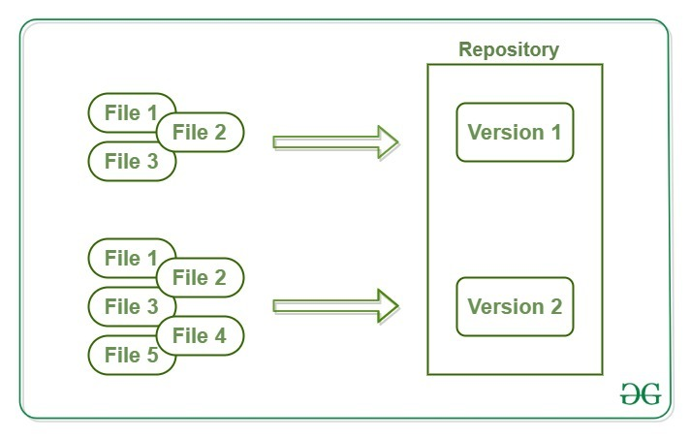
Bare Repositories: These repositories are used to share the changes that are done by different developers. A user is not allowed to modify this repository or create a new version for this repository based on the modifications done.
Non-bare Repositories: Non-bare repositories are user-friendly and hence allow the user to create new modifications of files and also create new versions for the repositories. The cloning process by default creates a non-bare repository if any parameter is not specified during the clone operation.

Slide 80
Working Area or Staging of a Git Repository
A working tree in a Git Repository is the collection of files which are originated from a certain version of the repository. It helps in tracking the changes done by a specific user on one version of the repository. Whenever an operation is committed by the user, Git will look only for the files which are present in the working area, and not all the modified files. Only the files which are present in the working area are considered for commit operation. The user of the working tree gets to change the files by modifying existing files and removing or creating files. There are a few stages of a file in the working tree of a repository:

Slide 81
Working Area or Staging of a Git Repository
Untracked: In this stage, the Git repository is unable to track the file, which means that the file is never staged nor it is committed.
Tracked: When the Git repository tracks a file, which means the file is committed but is not staged in the working directory.
Staged: In this stage, the file is ready to be committed and is placed in the staging area waiting for the next commit.
Modified/Dirty: When the changes are made to the file i.e. the file is modified but the change is not yet staged.
After the changes are done in the working area, the user can either update these changes in the GIT repository or revert the changes.

Slide 82
GitHub CLI
GitHub CLI is an open source tool for using GitHub from your computer's command line. When you're working from the command line, you can use the GitHub CLI to save time and avoid switching context.
GitHub CLI includes GitHub features such as:
View, create, clone, and fork repositories
Create, close, edit, and view issues and pull requests
Review, diff, and merge pull requests
Run, view, and list workflows
Create, list, view, and delete releases
Create, edit, list, view, and delete gists
List, create, delete, and connect to a codespace

Slide 83
Getting started
Install GitHub CLI on macOS, Windows, or Linux.
Set your username in Git.
Setting your Git username for every repository on your computer
Open Git Bash.
Set a Git username: $ git config --global user.name "Mona Lisa"
Confirm that you have set the Git username correctly: $ git config --global user.name > Mona Lisa
Setting your Git username for a single repository
Open Git Bash.
Change the current working directory to the local repository where you want to configure the name that is associated with your Git commits.
Set a Git username: $ git config user.name "Mona Lisa"
Confirm that you have set the Git username correctly:$ git config user.name > Mona Lisa

Slide 84
Setting your commit email address in Git
Open Git Bash. Set an email address in Git. You can use your GitHub-provided noreply email address or any email address.$ git config --global user.email "YOUR_EMAIL” Confirm that you have set the email address correctly in Git:$ git config --global user.email email@example.com Add the email address to your account on GitHub, so that your commits are attributed to you and appear in your contributions graph.

Slide 85
Signing Up for Github
With GitHub, you can store and collaborate on code. Accounts allow you to organize and control access to that code. There are three types of accounts on GitHub.
Every person who uses GitHub signs into a personal account. An organization account enhances collaboration between multiple personal accounts, and an enterprise account allows central management of multiple organizations.
Personal accounts
Organization accounts
Enterprise accounts

Slide 86
Personal accounts
Every person who uses GitHub.com signs into a personal account. Your personal account is your identity on GitHub.com and has a username and profile.
Your personal account can own resources such as repositories, packages, and projects. Any time you take any action on GitHub.com, such as creating an issue or reviewing a pull request, the action is attributed to your personal account.
Each personal account uses either GitHub Free or GitHub Pro. All personal accounts can own an unlimited number of public and private repositories, with an unlimited number of collaborators on those repositories. If you use GitHub Free, private repositories owned by your personal account have a limited feature set. You can upgrade to GitHub Pro to get a full feature set for private repositories.

Slide 87
Organization accounts
Organizations are shared accounts where an unlimited number of people can collaborate across many projects at once.
Like personal accounts, organizations can own resources such as repositories, packages, and projects. However, you cannot sign into an organization. Instead, each person signs into their own personal account, and any actions the person takes on organization resources are attributed to their personal account. Each personal account can be a member of multiple organizations.
The personal accounts within an organization can be given different roles in the organization, which grant different levels of access to the organization and its data. All members can collaborate with each other in repositories and projects, but only organization owners and security managers can manage the settings for the organization and control access to the organization's data with sophisticated security and administrative features.

Slide 88
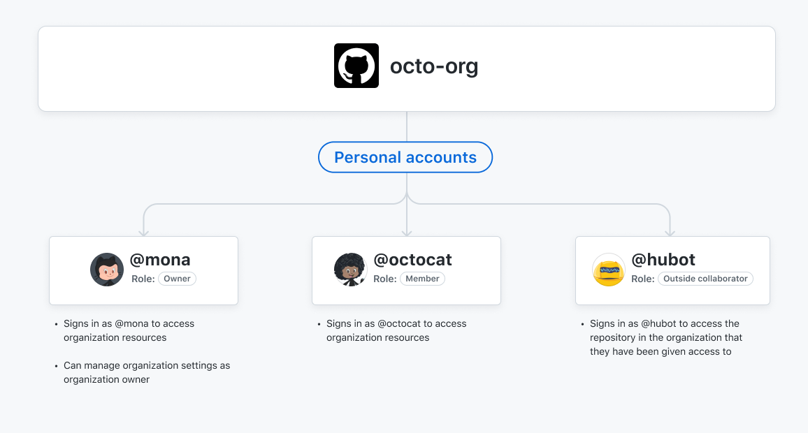

Slide 89
Enterprise accounts
Your enterprise account on GitHub.com allows you to manage multiple organizations. Your enterprise account must have a handle, like an organization or user account on GitHub.
Organizations are shared accounts where enterprise members can collaborate across many projects at once. Organization owners can manage access to the organization's data and projects with sophisticated security and administrative features.
In the enterprise settings, enterprise owners can invite existing organizations to join your enterprise account, transfer organizations between enterprise accounts, or create new organizations.
Your enterprise account allows you to manage and enforce policies for all the organizations owned by the enterprise. Each enterprise policy controls the options available for a policy at the organization level. You can choose to not enforce a policy, which allows organization owners to configure the policy for the organization, or you can choose from a set of options to enforce for all organizations owned by your enterprise.

Slide 90
Getting started with your GitHub account
Part 1: Configuring your GitHub account
The first steps in starting with GitHub are to create an account, choose a product that fits your needs best, verify your email, set up two-factor authentication, and view your profile.
There are several types of accounts on GitHub. Every person who uses GitHub has their own personal account, which can be part of multiple organizations and teams. Your personal account is your identity on GitHub.com and represents you as an individual.

Slide 91
1. Creating an account
To sign up for an account on GitHub.com, navigate to https://github.com/ and follow the prompts.
To keep your GitHub account secure you should use a strong and unique password.
2. Choosing your GitHub product
You can choose GitHub Free or GitHub Pro to get access to different features for your personal account. You can upgrade at any time if you are unsure at first which product you want.
3. Verifying your email address
To ensure you can use all the features in your GitHub plan, verify your email address after signing up for a new account.

Slide 92
4. Configuring two-factor authentication
Two-factor authentication, or 2FA, is an extra layer of security used when logging into websites or apps. We strongly urge you to configure 2FA for the safety of your account.
5. Viewing your GitHub profile and contribution graph
Your GitHub profile tells people the story of your work through the repositories and gists you've pinned, the organization memberships you've chosen to publicize, the contributions you've made, and the projects you've created.

Slide 93
Getting started with GitHub Team
Part 1: Configuring your account on GitHub.com
As the first steps in starting with GitHub Team, you will need to create a personal account or log into your existing account on GitHub, create an organization, and set up billing.
1. About organizations
Organizations are shared accounts where businesses and open-source projects can collaborate across many projects at once. Owners and administrators can manage member access to the organization's data and projects with sophisticated security and administrative features.

Slide 94
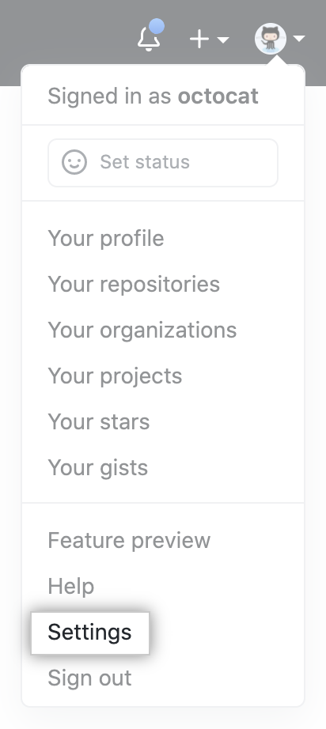
2. Creating an organization and signing up for GitHub Team
When you create a new organization from scratch, it doesn't have any repositories associated with it.
In the upper-right corner of any page, click your profile photo, then click Settings.

Slide 95
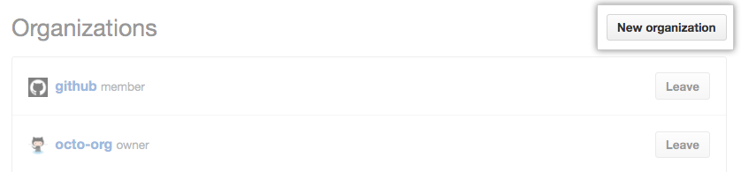
In the "Access" section of the sidebar, click Organizations.
In the "Organizations" section, click New organization.
Follow the prompts to create your organization.Follow the prompts to create your organization.

Slide 96
3. Managing billing for an organization
You must manage billing settings, payment method, and paid features and products for each of your personal accounts and organizations separately. You can switch between settings for your different accounts using the context switcher in your settings.
Your organization's billing settings page allows you to manage settings like your payment method, billing cycle and billing email, or view information such as your subscription, billing date and payment history. You can also view and upgrade your storage and GitHub Actions minutes.
Only organization members with the owner or billing manager role can access or change billing settings for your organization. A billing manager is someone who manages the billing settings for your organization and does not use a paid license in your organization's subscription.

Slide 97
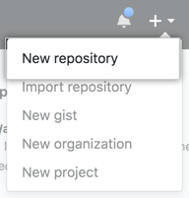
Create a Repo
In the upper-right corner of any page, use the drop-down menu, and select New repository.

Slide 98
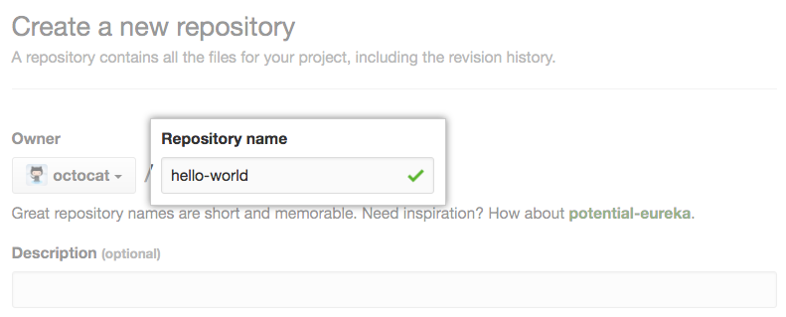
Type a short, memorable name for your repository. For example, "hello-world".

Slide 99
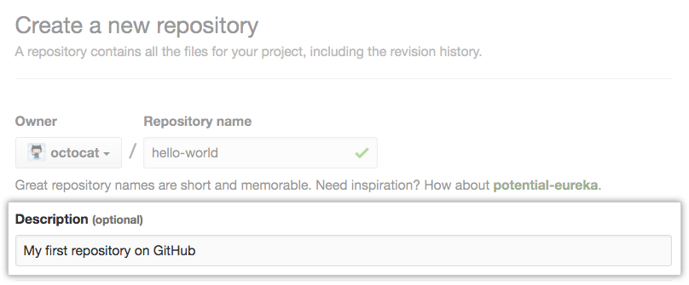
Optionally, add a description of your repository. For example, "My first repository on GitHub."

Slide 100
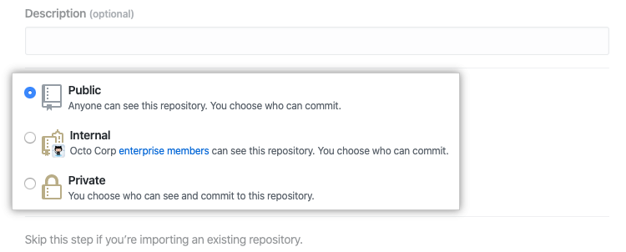
Choose a repository visibility.

Slide 101
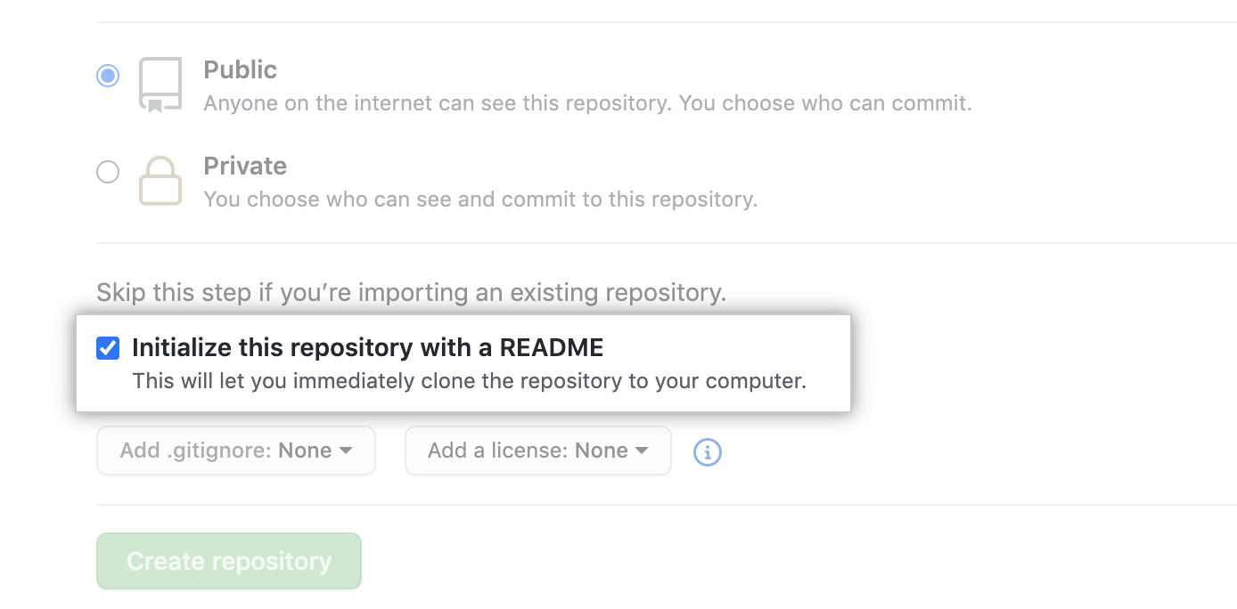
Select Initialize this repository with a README.

Slide 102
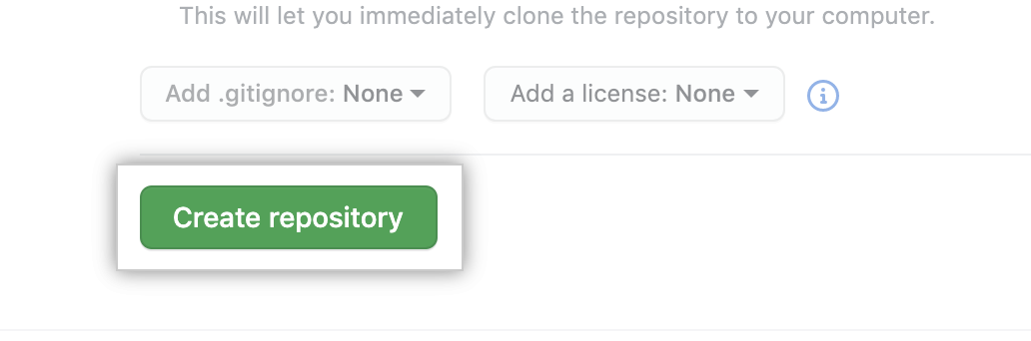
Click Create repository.

Slide 103
Fork a repo
A fork is a new repository that shares code and visibility settings with the original “upstream” repository. Forks are often used to iterate on ideas or changes before they are proposed back to the upstream repository, such as in open source projects or when a user does not have write access to the upstream repository.
Propose changes to someone else's project
For example, you can use forks to propose changes related to fixing a bug. Rather than logging an issue for a bug you have found, you can:
Fork the repository.
Make the fix.
Submit a pull request to the project owner.

Slide 104

On GitHub.com, navigate to the octocat/Spoon-Knife repository.
In the top-right corner of the page, click Fork.

Slide 105
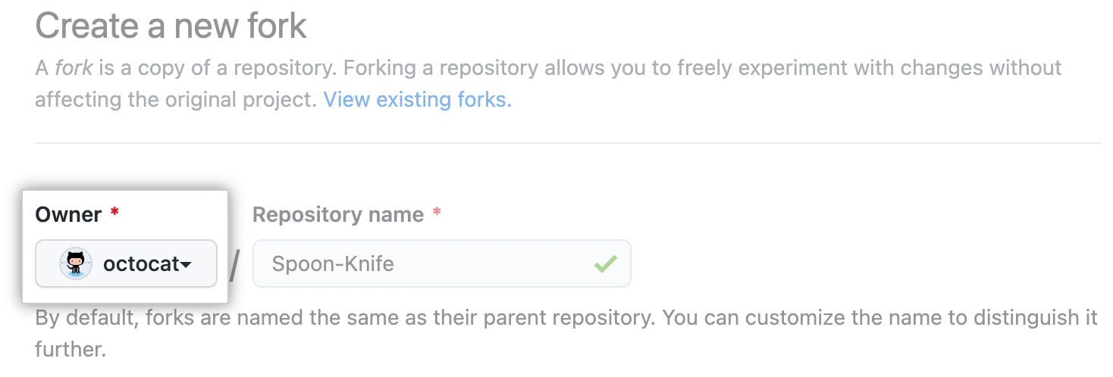
Select an owner for the forked repository.

Slide 106
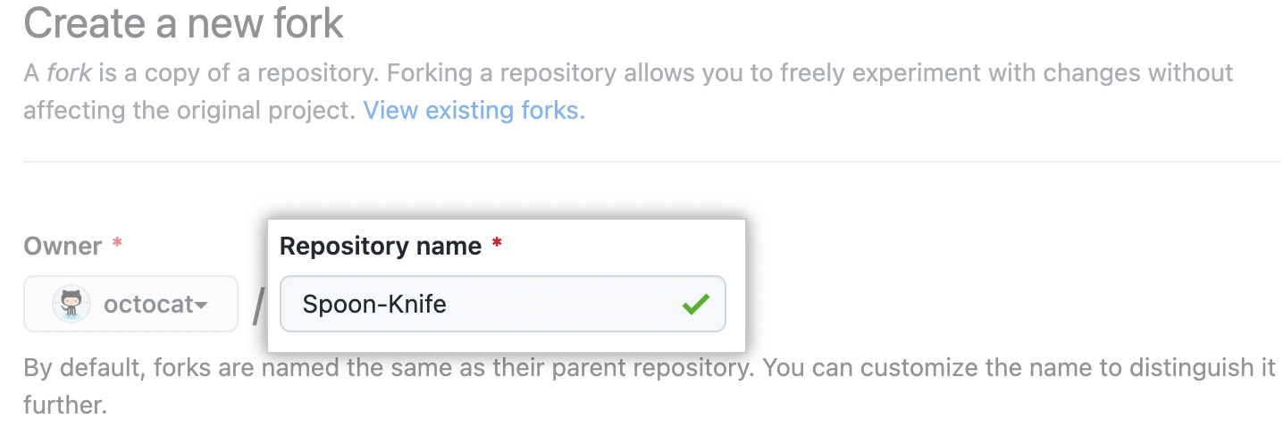
By default, forks are named the same as their upstream repositories. You can change the name of the fork to distinguish it further.

Slide 107
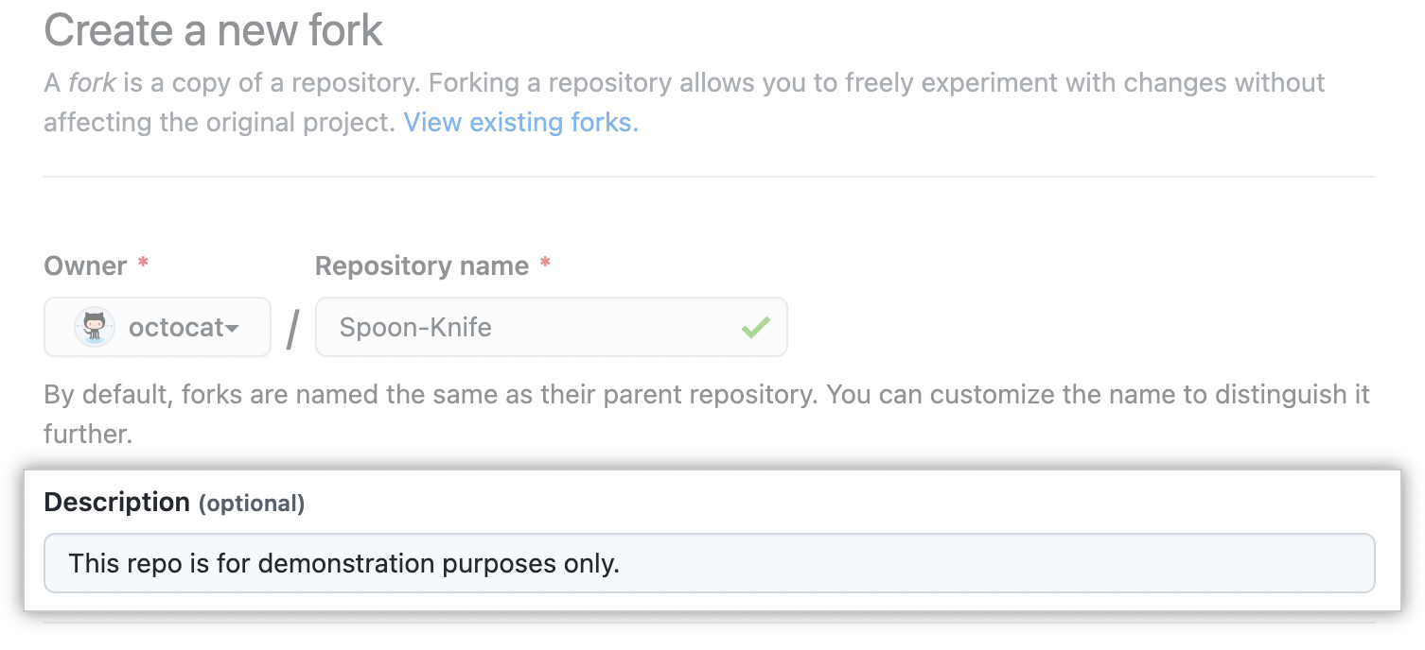
Optionally, add a description of your fork.

Slide 108
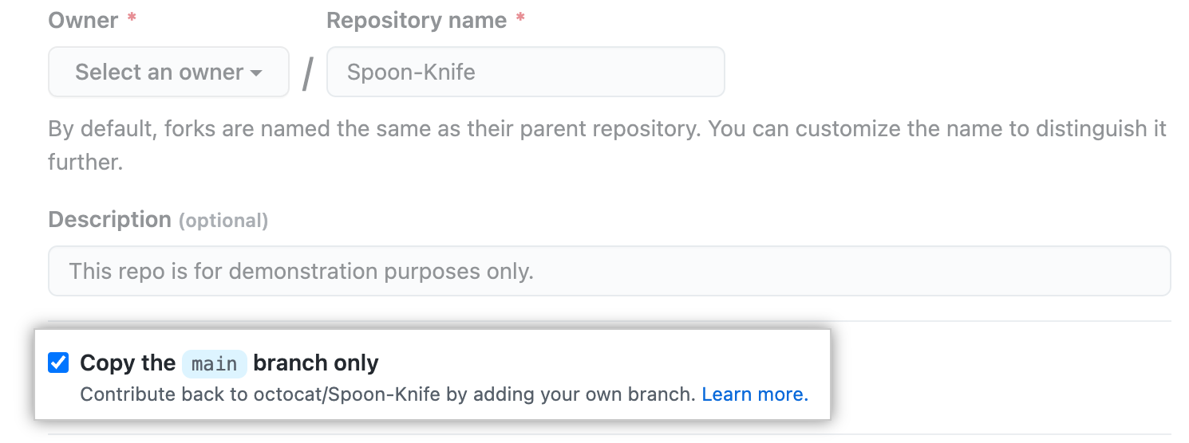
Choose whether to copy only the default branch or all branches to the new fork. For many forking scenarios, such as contributing to open-source projects, you only need to copy the default branch. By default, only the default branch is copied.

Slide 109
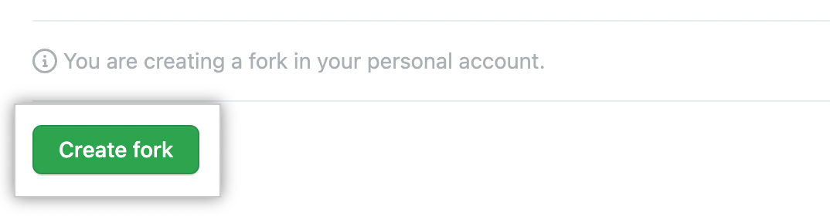
Click Create fork.

Slide 110
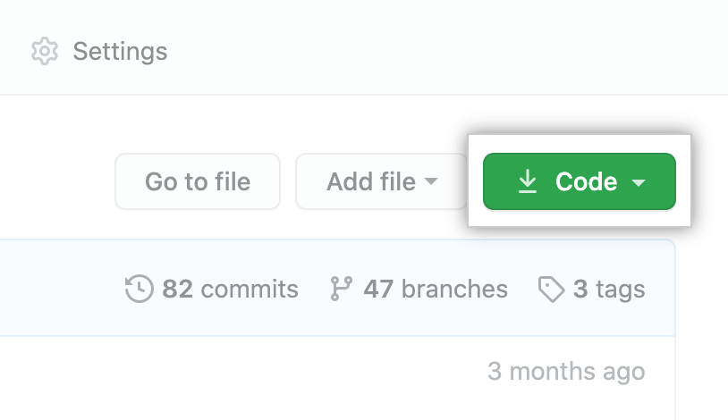
Cloning your forked repository
Right now, you have a fork of the Spoon-Knife repository, but you do not have the files in that repository locally on your computer.
On GitHub.com, navigate to your fork of the Spoon-Knife repository.
Above the list of files, click Code.

Slide 111
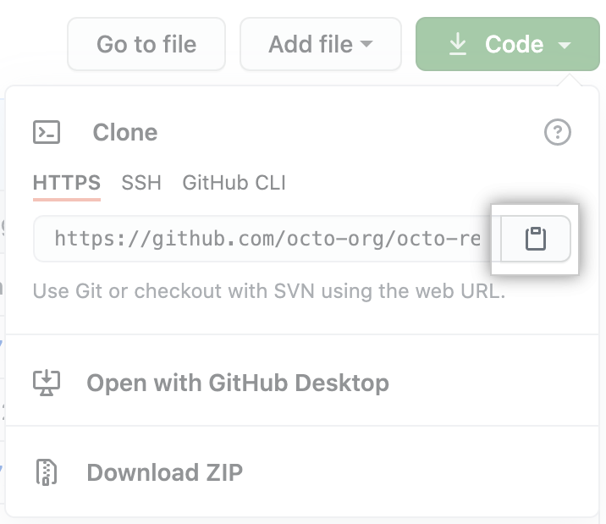
Copy the URL for the repository.
To clone the repository using HTTPS, under "HTTPS", click .
To clone the repository using an SSH key, including a certificate issued by your organization's SSH certificate authority, click SSH, then click .
To clone a repository using GitHub CLI, click GitHub CLI, then click .

Slide 112
Open Git Bash.
Change the current working directory to the location where you want the cloned directory.
Type git clone, and then paste the URL you copied earlier. It will look like this, with your GitHub username instead of YOUR-USERNAME: $ git clone https://github.com/YOUR-USERNAME/Spoon-Knife
Press Enter. Your local clone will be created. $ git clone https://github.com/YOUR-USERNAME/Spoon-Knife
> Cloning into `Spoon-Knife`...
> remote: Counting objects: 10, done.
> remote: Compressing objects: 100% (8/8), done.
> remote: Total 10 (delta 1), reused 10 (delta 1)
> Unpacking objects: 100% (10/10), done.

Slide 113
Configuring Git to sync your fork with the upstream repository
Change directories to the location of the fork you cloned.
To go to your home directory, type just cd with no other text.
To list the files and folders in your current directory, type ls.
To go into one of your listed directories, type cd your_listed_directory.
To go up one directory, type cd..
Type git remote -v and press Enter. You will see the current configured remote repository for your fork. $ git remote -v
> origin https://github.com/YOUR_USERNAME/YOUR_FORK.git (fetch)
> origin https://github.com/YOUR_USERNAME/YOUR_FORK.git (push)
Type git remote add upstream, and then paste the URL you copied in Step 3 and press Enter. It will look like this: $ git remote add upstream https://github.com/ORIGINAL_OWNER/Spoon-Knife.git

Slide 114
To verify the new upstream repository you have specified for your fork, type git remote -v again. You should see the URL for your fork as origin, and the URL for the upstream repository as upstream. $ git remote -v
> origin https://github.com/YOUR_USERNAME/YOUR_FORK.git (fetch)
> origin https://github.com/YOUR_USERNAME/YOUR_FORK.git (push)
> upstream https://github.com/ORIGINAL_OWNER/ORIGINAL_REPOSITORY.git (fetch)
> upstream https://github.com/ORIGINAL_OWNER/ORIGINAL_REPOSITORY.git (push)

Slide 115
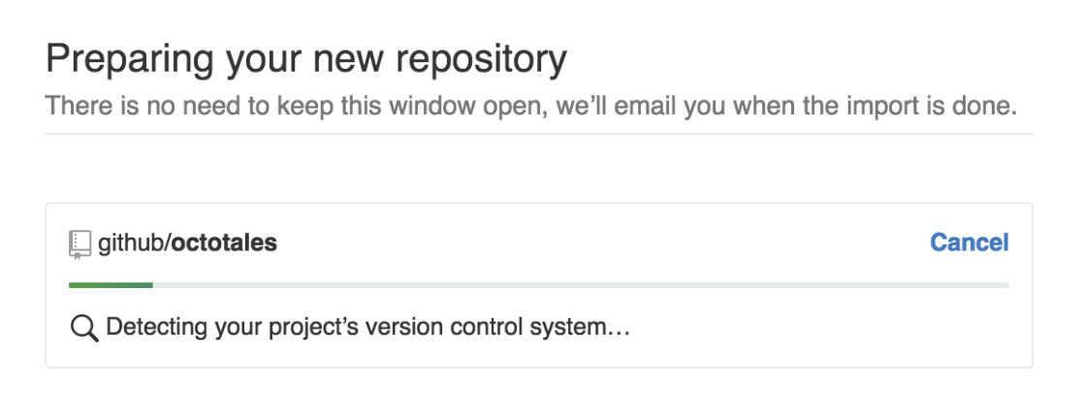
Import code to github
GitHub Importer is a tool that quickly imports source code repositories, including commits and revision history, to GitHub for you.
During an import, depending on the version control system you're importing from, you can authenticate with your remote repository, update commit author attribution, and import repositories with large files (or remove large files if you don't want to use Git Large File Storage).

Slide 116
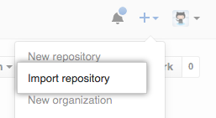
In the upper-right corner of any page, click , and then click Import repository.

Slide 117
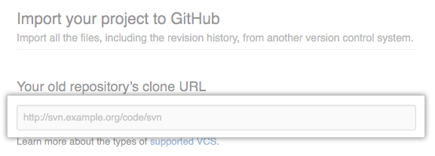
Under "Your old repository's clone URL", type the URL of the project you want to import.

Slide 118
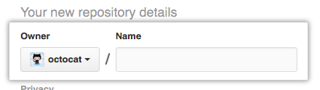
Choose your personal account or an organization to own the repository, then type a name for the repository on GitHub.

Slide 119
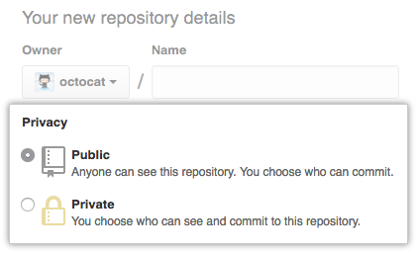
Specify whether the new repository should be public or private.

Slide 120
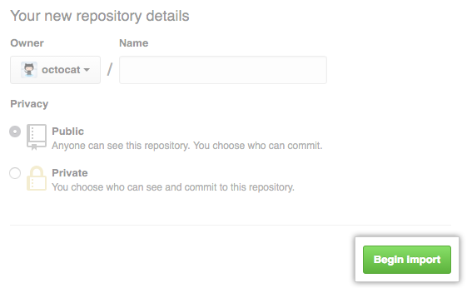
Review the information you entered, then click Begin import.

Slide 121
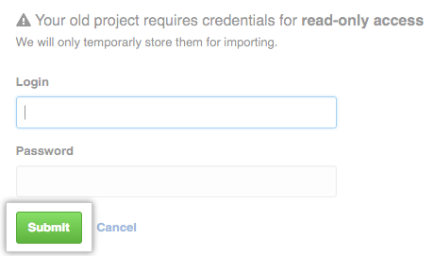
If your old project requires credentials, type your login information for that project, then click Submit. If SAML SSO or 2FA are enabled for your user account on the old project, enter a personal access token with repository read permissions in the "Password" field instead of your password.

Slide 122
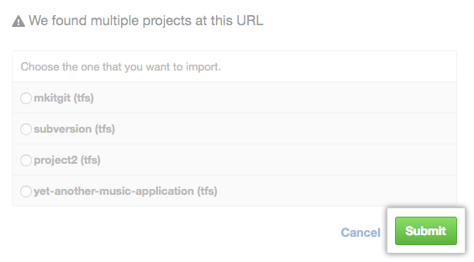
If there are multiple projects hosted at your old project's clone URL, choose the project you'd like to import, then click Submit.

Slide 123
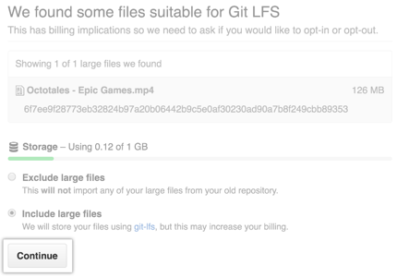
If your project contains files larger than 100 MB, choose whether to import the large files using Git Large File Storage, then click Continue.

Slide 124
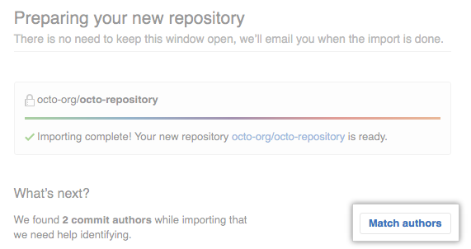
Updating commit authors
After you've imported your repository, on the import status page, click Match authors.

Slide 125
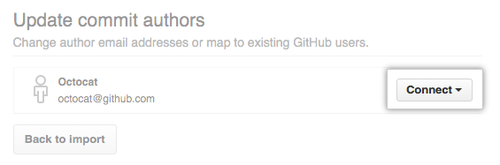
Next to the author whose information you'd like to update, click Connect.
Type the email address or GitHub username of the author, then press Enter.

Slide 126
Importing a Git repository using the command line
If GitHub Importer is not suitable for your purposes, such as if your existing code is hosted on a private network, then we recommend importing using the command line.
Before you start, make sure you know:
Your GitHub username
The clone URL for the external repository, such as https://external-host.com/user/repo.git or git://external-host.com/user/repo.git (perhaps with a user@ in front of the external-host.com domain name)

Slide 127
1. Create a new repository on GitHub. You'll import your external Git repository to this new repository.
On the command line, make a "bare" clone of the repository using the external clone URL. This creates a full copy of the data, but without a working directory for editing files, and ensures a clean, fresh export of all the old data. $ git clone --bare https://external-host.com/EXTUSER/REPO.git
1. # Makes a bare clone of the external repository in a local directory
Push the locally cloned repository to GitHub using the "mirror" option, which ensures that all references, such as branches and tags, are copied to the imported repository. $ cd REPO.git
$ git push --mirror https://github.com/USER/REPO.git
1. # Pushes the mirror to the new repository on GitHub.com
Remove the temporary local repository. $ cd ..
1. $ rm -rf REPO.git

Slide 128
Adding a local repository to GitHub with GitHub CLI
In the command line, navigate to the root directory of your project.
Initialize the local directory as a Git repository. git init -b main
Stage and commit all the files in your project. git add . && git commit -m "initial commit"
To create a repository for your project on GitHub, use the gh repo create subcommand. When prompted, select Push an existing local repository to GitHub and enter the desired name for your repository. If you want your project to belong to an organization instead of your user account, specify the organization name and project name with organization-name/project-name.
Follow the interactive prompts. To add the remote and push the repository, confirm yes when asked to add the remote and push the commits to the current branch.
Alternatively, to skip all the prompts, supply the path to the repository with the --source flag and pass a visibility flag (--public, --private, or --internal). For example, gh repo create --source=. --public. Specify a remote with the --remote flag. To push your commits, pass the --push flag.

Slide 129
Adding a local repository to GitHub with GitHub CLI
Create a new repository on GitHub.com. To avoid errors, do not initialize the new repository with README, license, or gitignore files. You can add these files after your project has been pushed to GitHub.

Slide 130
Open Git Bash.
Change the current working directory to your local project.
Use the init command to initialize the local directory as a Git repository. By default, the initial branch is called main. If you’re using Git 2.28.0 or a later version, you can set the name of the default branch using -b. $ git init -b main If you’re using Git 2.27.1 or an earlier version, you can set the name of the default branch using && git symbolic-ref HEAD refs/heads/main. $ git init && git symbolic-ref HEAD refs/heads/main
Add the files in your new local repository. This stages them for the first commit. $ git add .

Slide 131
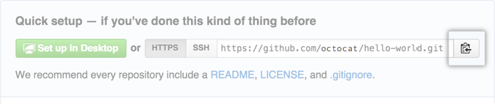
Commit the files that you've staged in your local repository. $ git commit -m "First commit"
# Commits the tracked changes and prepares them to be pushed to a remote repository. To remove this commit and modify the file, use 'git reset --soft HEAD~1' and commit and add the file again.
At the top of your repository on GitHub.com's Quick Setup page, click to copy the remote repository URL.

Slide 132
In the Command prompt, add the URL for the remote repository where your local repository will be pushed. $ git remote add origin <REMOTE_URL>
# Sets the new remote
$ git remote –v
# Verifies the new remote URL
Push the changes in your local repository to GitHub.com. $ git push origin main

Slide 133
Git Commands
Configure tooling
Configure user information for all local repositories $ git config --global user.name "[name]"
Sets the name you want attached to your commit transactions $ git config --global user.email "[email address]"
Sets the email you want attached to your commit transactions $ git config --global color.ui auto
Enables helpful colorization of command line output

Slide 134
Branches
Branches are an important part of working with Git. Any commits you make will be made on the branch you’re currently “checked out” to. Use git status to see which branch that is.
$ git branch [branch-name] Creates a new branch
$ git switch -c [branch-name] Switches to the specified branch and updates the working directory
$ git merge [branch] Combines the specified branch’s history into the current branch. This is usually done in pull requests, but is an important Git operation.
$ git branch -d [branch-name] Deletes the specified branch

Slide 135
Make changes
Browse and inspect the evolution of project files $ git log
Lists version history for the current branch $ git log --follow [file]
Lists version history for a file, beyond renames (works only for a single file) $ git diff [first-branch]...[second-branch]
Shows content differences between two branches $ git show [commit]
Outputs metadata and content changes of the specified commit $ git add [file]
Snapshots the file in preparation for versioning $ git commit -m "[descriptive message]"
Records file snapshots permanently in version history

Slide 136
Redo commits
Erase mistakes and craft replacement history $ git reset [commit]
Undoes all commits after [commit], preserving changes locally $ git reset --hard [commit]
Discards all history and changes back to the specified commit

Slide 137
Create repositories
A new repository can either be created locally, or an existing repository can be cloned. When a repository was initialized locally, you have to push it to GitHub afterwards. $ git init
The git init command turns an existing directory into a new Git repository inside the folder you are running this command. After using the git init command, link the local repository to an empty GitHub repository using the following command: $ git remote add origin [url]
Specifies the remote repository for your local repository. The url points to a repository on GitHub. $ git clone [url]
Clone (download) a repository that already exists on GitHub, including all of the files, branches, and commits

Slide 138
Synchronize change
Synchronize your local repository with the remote repository on GitHub.com $ git fetch
Downloads all history from the remote tracking branches $ git merge
Combines remote tracking branches into current local branch $ git push
Uploads all local branch commits to GitHub $ git pull
Updates your current local working branch with all new commits from the corresponding remote branch on GitHub. git pull is a combination of git fetch and git merge

Slide 139
Glossary
git: an open source, distributed version-control system
GitHub: a platform for hosting and collaborating on Git repositories
commit: a Git object, a snapshot of your entire repository compressed into a SHA
branch: a lightweight movable pointer to a commit
clone: a local version of a repository, including all commits and branches
remote: a common repository on GitHub that all team members use to exchange their changes
fork: a copy of a repository on GitHub owned by a different user
pull request: a place to compare and discuss the differences introduced on a branch with reviews, comments, integrated tests, and more
HEAD: representing your current working directory, the HEAD pointer can be moved to different branches, tags, or commits when using git switch

Slide 140
In earlier days Iterative Waterfall model was very popular to complete a project. But nowadays developers face various problems while using it to develop software. The main difficulties included handling customer change requests during project development and the high cost and time required to incorporate these changes. To overcome these drawbacks of the Waterfall model, in the mid-1990s the Agile Software Development model was proposed.

Slide 141
The Agile model was primarily designed to help a project adapt to change requests quickly. So, the main aim of the Agile model is to facilitate quick project completion. To accomplish this task agility is required. Agility is achieved by fitting the process to the project and removing activities that may not be essential for a specific project. Also, anything that is waste of time and effort is avoided.

Slide 142
Agile SDLC models:
Crystal: Crystal Agile methodology places a strong emphasis on fostering effective communication and collaboration among team members, as well as taking into account the human elements that are crucial for a successful development process. This methodology is particularly beneficial for projects with a high degree of uncertainty, where requirements tend to change frequently.
Atern: This methodology is tailored for projects with moderate to high uncertainty, where requirements are prone to change frequently. Its clear-cut roles and responsibilities focus on delivering working software in short time frames, and governance practices set it apart and make it an effective approach for teams and projects.

Slide 143
Feature-driven development: This approach is implemented by utilizing a series of techniques like creating feature lists, conducting model evaluations, and implementing a design-by-feature method to meet its goal. This methodology is particularly effective in ensuring that the end product is delivered in a timely manner and that it aligns with the requirements of the customer.
Scrum: This methodology serves as a framework for tackling complex projects and ensuring their successful completion. It is led by a Scrum Master, who oversees the process, and a Product Owner, who establishes the priorities. The Development Team, accountable for delivering the software, is another key player.
Extreme programming (XP): It uses specific practices like pair programming, continuous integration, and test-driven development to achieve these goals. Extreme programming is ideal for projects that have high levels of uncertainty and require frequent changes, as it allows for quick adaptation to new requirements and feedback.

Slide 144
Lean development: It is rooted in the principles of Lean Manufacturing and aims to streamline the process by identifying and removing unnecessary steps and activities. This is achieved through practices such as continuous improvement, visual management, and value stream mapping, which helps in identifying areas of improvement and implementing changes accordingly.
Unified process: Unified Process is a methodology that can be tailored to the specific needs of any given project. It combines elements of both waterfall and Agile methodologies, allowing for an iterative and incremental approach to development. This means that the UP is characterized by a series of iterations, each of which results in a working product increment, allowing for continuous improvement and delivery of value to the customer.

Slide 145
The steps involve in agile SDLC models are:
Requirement gathering
Requirement Analysis
Design
Coding
Unit testing
Acceptance testing
The time to complete an iteration is known as a Time Box. Time-box refers to the maximum amount of time needed to deliver an iteration to customers. So, the end date for an iteration does not change. However, the development team can decide to reduce the delivered functionality during a Time-box if necessary to deliver it on time. The central principle of the Agile model is the delivery of an increment to the customer after each Time-box.

Slide 146
Principles of Agile model:
To establish close contact with the customer during development and to gain a clear understanding of various requirements, each Agile project usually includes a customer representative on the team. At the end of each iteration stakeholders and the customer representative review, the progress made and re-evaluate the requirements.
The agile model relies on working software deployment rather than comprehensive documentation.
Frequent delivery of incremental versions of the software to the customer representative in intervals of a few weeks.
Requirement change requests from the customer are encouraged and efficiently incorporated.
It emphasizes having efficient team members and enhancing communications among them is given more importance. It is realized that enhanced communication among the development team members can be achieved through face-to-face communication rather than through the exchange of formal documents.
It is recommended that the development team size should be kept small (5 to 9 people) to help the team members meaningfully engage in face-to-face communication and have a collaborative work environment.
The agile development process usually deploys Pair Programming. In Pair programming, two programmers work together at one workstation. One does coding while the other reviews the code as it is typed in. The two programmers switch their roles every hour or so.

Slide 147
Advantages:
Working through Pair programming produces well-written compact programs which have fewer errors as compared to programmers working alone.
It reduces the total development time of the whole project.
Agile development emphasizes face-to-face communication among team members, leading to better collaboration and understanding of project goals.
Customer representatives get the idea of updated software products after each iteration. So, it is easy for him to change any requirement if needed.
Agile development puts the customer at the center of the development process, ensuring that the end product meets their needs.

Slide 148
Disadvantages:
The lack of formal documents creates confusion and important decisions taken during different phases can be misinterpreted at any time by different team members.
Agile development models often involve working in short sprints, which can make it difficult to plan and forecast project timelines and deliverables. This can lead to delays in the project and can make it difficult to accurately estimate the costs and resources needed for the project.
Agile development models require a high degree of expertise from team members, as they need to be able to adapt to changing requirements and work in an iterative environment. This can be challenging for teams that are not experienced in agile development practices and can lead to delays and difficulties in the project.
Due to the absence of proper documentation, when the project completes and the developers are assigned to another project, maintenance of the developed project can become a problem.

Slide 149
SCRUM
Scrum is the type of Agile framework. It is a framework within which people can address complex adaptive problem while productivity and creativity of delivering product is at highest possible values. Scrum uses Iterative process.

Slide 150
Silent features of Scrum are:
Scrum is light-weighted framework
Scrum emphasizes self-organization
Scrum is simple to understand
Scrum framework help the team to work together

Slide 151
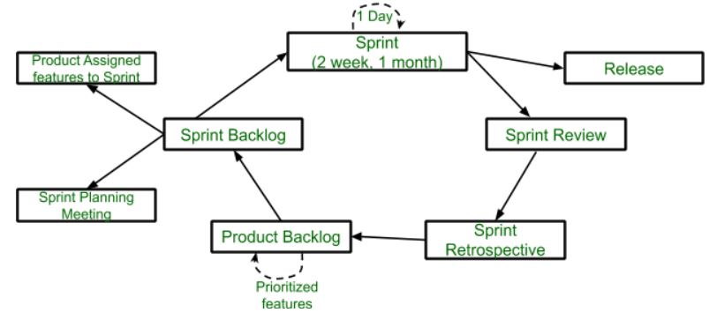
Lifecycle

Slide 152
Sprint: A Sprint is a time-box of one month or less. A new Sprint starts immediately after the completion of the previous Sprint.
Release: When the product is completed then it goes to the Release stage.
Sprint Review: If the product still have some non-achievable features then it will be checked in this stage and then the product is passed to the Sprint Retrospective stage.
Sprint Retrospective: In this stage quality or status of the product is checked.
Product Backlog: According to the prioritize features the product is organized.
Sprint Backlog: Sprint Backlog is divided into two parts Product assigned features to sprint and Sprint planning meeting.

Slide 153
Advantage of using Scrum framework:
Scrum framework is fast moving and money efficient.
Scrum framework works by dividing the large product into small sub-products. It’s like a divide and conquer strategy
In Scrum customer satisfaction is very important.
Scrum is adaptive in nature because it have short sprint.
As Scrum framework rely on constant feedback therefore the quality of product increases in less amount of time

Slide 154
Disadvantage of using Scrum framework:
Scrum framework do not allow changes into their sprint.
Scrum framework is not fully described model. If you wanna adopt it you need to fill in the framework with your own details like Extreme Programming(XP), Kanban, DSDM.
It can be difficult for the Scrum to plan, structure and organize a project that lacks a clear definition.
The daily Scrum meetings and frequent reviews require substantial resources.

Slide 155
Difference between Agile and Scrum Testing
Agile Testing: Agile testing is a type of software testing that is performed alongside the software development. It is the part of Agile Software Development in which the development and the testing process goes side by side. When in software development life cycle development and the testing goes parallel way then it is known as agile development process.
Scrum Testing: Scrum testing is a type of software testing that is the part of agile testing. It is basically a framework used in agile software development process. Scrum testing is used to design the complicated software. It also checks the quality, performance and the usability of the software.

